Slide 1
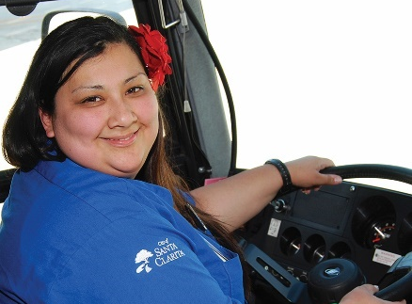
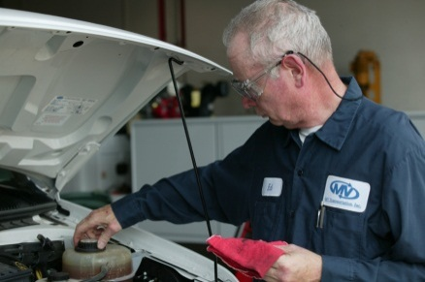
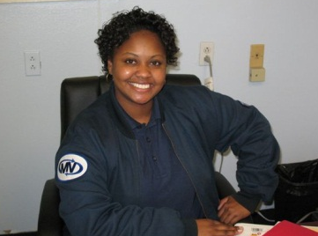
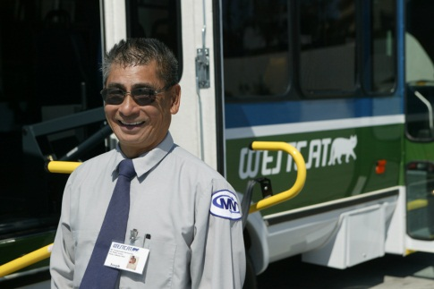
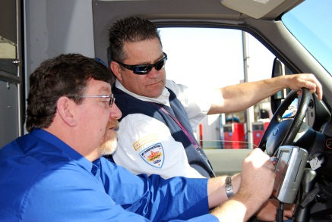
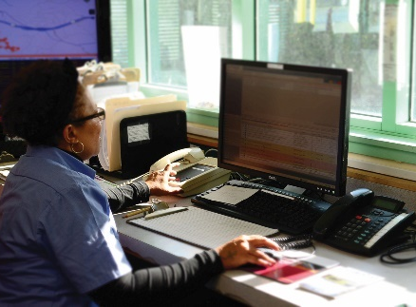
Partnership SAFETY INNOVATION
Community Transportation Coordinator for Alachua, Hardee Highlands Okeechobee and DeSoto Counties

Slide 2
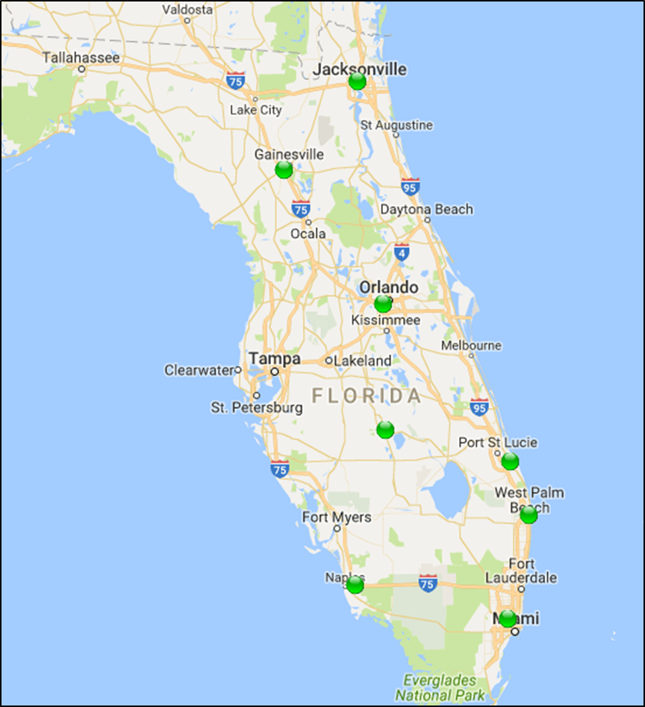
MV Florida Presence

Slide 3
MV Presence in Florida
Alachua County CTC since 2003
LYNX Orlando since 2002 - Paratransit provider
Palm Beach County – Paratransit provider 2005-12 / 2014
Martin County - Fixed Route and Paratransit Provider 2011
JTA Jacksonville – Paratransit Provider 2014
St. Lucie- Medicaid HMO and limited County service 2012
Hialeah/ Miami Lakes – Fixed Route – 2010
Collier County - Paratransit Provider – 2015
Hardee Highlands Okeechobee CTC – November 2015
Desoto CTC – January 2016

Slide 4
Partnership with CTD
CTC for Alachua County since 2003
CTC for Hardee Highlands Okeechobee since 2015
CTC for Desoto since 2106
Medicaid STP Provider – Several counties during transition
Annual Conference Sponsor
TD Day Sponsor

Slide 5
System Operating Model Hardee Highlands Okeechobee DeSoto
FULL BROKERAGE
MV – Reservations, Scheduling, Administrative
Positive Medical Transport – HHO
Robert Layne
Safety Transportation – HHO, Desoto
Crystal Oliveros
JJ Transport – Desoto
Madelon Mansfield

Slide 6




Elected Officials Local Coordinating Board
Hardee County
County Commissioner Russell Melendy
Highlands County
County Commissioner Don Elwell
Okeechobee County
Vacant
DeSoto County
County Commissioner Tony Hill

Slide 7

Agency Partners
CENTRAL FLORIDA REGIONAL PLANNING COUNCIL
Hardee Highlands Okeechobee
5310 AND 5311 Funding
5310 Grant Vehicles
Pat Steed, E.D., Ken Harley staff
Desoto County
5310 Grant Vehicles
5311 Funding
Marcia Staszko, staff

Slide 8
Facility Partners
Hardee County
Nu Hope Elder Care Services of Hardee County
Sunrise Community of Hardee County (Coordination Contract)
Fresenius Dialysis of Hardee
Highlands County
Nu Hope Elder Care Services of Highlands County
Change of Pace (Alzheimer’s Day Program)
Ridge Area ARC (Coordination Contract)
New Concepts by Visions (Coordination Contract)
Fresenius Dialysis of Highlands (2-Centers in Sebring)
Highlands Dialysis Sebring (ARA Dialysis)
• Okeechobee County
Okeechobee Senior Services
Big Lake Kidney Center (ARA Dialysis)

Slide 9
Funding Streams
DeSoto - CTD, 5311, Local Match, Vocational Rehab
Hardee - CTD, 5310, 5311, Local Match, Nu Hope Elder Care Services, Vocational Rehab and MTM
Highlands - CTD, 5310, 5311, Local Match, Nu Hope, Vocational Rehab, MTM – APD Clients through TDTF
Okeechobee - CTD, 5310,5311, Local Match, OSS (Okeechobee Senior Services) and Vocational Rehab

Slide 10
FDOT Bus Transit System Safety, Security and Maintenance Review
Partnership with CFRPC
Grant Vehicles
5310 and 5311 Operating Grants
FDOT / CUTR/ FSU
Trapeze TEAM Maintenance Tracking
Staff monitoring
Strict compliance with 14-90

Slide 11
Operating Statistics Hardee Highlands Okeechobee Counties
Current Service Population Hardee, 27,502; Highlands 99,491; Okeechobee 39,469 Potential TD Population Hardee 10,786; Highlands 63,722; Okeechobee 23,464
How is Service Provided (taxi, bus, etc) Paratransit Door to Door
How Often is Service Provided (Frequency) Monday – Saturday 4:00 am – 8:00 pm
Distance covered (one mile, five miles, etc) Average Trip Length – 11.61 miles
How is Service Accessed Reservations through toll free number – Application qualification process
What are the Service Costs Ambulatory $38.11; Wheelchair $65.33; Stretcher $136.10 Copayments $1.00 in county, $3.00 out of county

Slide 12
Hardee Highlands Okeechobee Counties
Problems/Challenges with Providing or Accessing Services Contracted with Medicaid HMO broker, will schedule an entire family but only pay for one passenger
Barriers Serving Individuals with Intellectual or Developmental Disabilities Unable to get assistance from APD with securing a Medicaid Waiver number so we can bill for services
Potential Solutions to Barriers APD to assist in allowing us to bill for services – several passengers are being billed to TD (supplanting funds)
Successes (What Worked and Why) Significant improvements in quality of service and customer service. Great relationships with agencies
Additional Notes Some of our contracted providers are contracted with Medicaid HMO brokers, which fragments the coordinated system

Slide 13
Operating Statistics Desoto County
Current Service Population Population – 27,502 Potential TD Population – 16,282
How is Service Provided (taxi, bus, etc) Paratransit Door to Door
How Often is Service Provided (Frequency) Monday – Saturday 4:00 am – 8:00 pm
Distance covered (one mile, five miles, etc) Average Trip Length – 11.61 miles
How is Service Accessed Reservations through toll free number – Application qualification process
What are the Service Costs Ambulatory $45.67; Wheelchair $78.29; Stretcher $163.10 Copay $1.00 in county, $3.00 - $10.00 out of county

Slide 14
Desoto County
Problems/Challenges with Providing or Accessing Services Have been overspending TD funds, and 5311 funds have to be matched by soft match, which has been an issue
Barriers Serving Individuals with Intellectual or Developmental Disabilities Fragmented system with Medicaid HMO provided by contracted providers outside of CTC system
Potential Solutions to Barriers Dismantle fragmented Medicaid HMO brokerage model
Successes (What Worked and Why) Improvements in service quality
Additional Notes System will eventually be incorporated with HHO system

Slide 15
System Operating Model Alachua County
FULL SERVICE
MV Transportation –
Reservations
Scheduling
Eligibility
Transportation delivery
Administrative
Maintenance

Slide 16
FDOT Bus Transit System Safety, Security and Maintenance Review
Partnership with City of Gainesville
Grant Vehicles
5310 and 5311 Operating Grants
FDOT / CUTR/ FSU
Trapeze TEAM Maintenance Tracking
Staff monitoring
Strict compliance with 14-90

Slide 17
Agency Partners
NORTH CENTRAL FLORIDA REGIONAL PLANNING COUNCIL
Lynn Godfrey, staff
CITY OF GANESVILLE REGIONAL TRANSIT SYSTEM (RTS)
5310 Grant Vehicles
5311 Funding
ADA Funding
Millie Crawford, staff

Slide 18

Elected Officials Local Coordinating Board
Adrian Hayes-Santos
Chair, Local Coordinating Board

Slide 19
Alachua County Funding Streams
City of Gainesville RTS – ADA service
5310, 5311 – via City of Gainesville
Transportation Disadvantaged (TD)
Santa Fe College
CTD Mobility Enhancement Grant (MEG)
MTM – Medicaid Broker
Elder Care Services – Gainesville
Alachua County Emergency Operations Center
Alachua County “Foster Grandparents”

Slide 20
Operating Statistics Alachua County
Current Service Population Population – 259,964 Potential TD Population – 105,236
How is Service Provided (taxi, bus, etc) Paratransit Door to Door
How Often is Service Provided (Frequency) Monday – Saturday 4:00 am – 9:00 pm Sunday 9:00 am – 5:00 pm
Distance covered (one mile, five miles, etc) Average Trip Length – 12.35 miles
How is Service Accessed Reservations through toll free number – Application qualification process
What are the Service Costs TD Ambulatory $34.05; Wheelchair $58.35; Stretcher $121.55 Copay ADA $3.00 , TD $2.00, Dialysis $2.00

Slide 21
Alachua County
Problems/Challenges with Providing or Accessing Services Fragmented system with Medicaid HMO provided by contracted providers outside of CTC system
Barriers Serving Individuals with Intellectual or Developmental Disabilities Discontinued relationship with APD several years ago. Several APD clients being sponsored by TD and ADA transportation
Potential Solutions to Barriers Dismantle fragmented Medicaid HMO brokerage model Simplify APD administrative requirements
Successes (What Worked and Why) CTC since 2003, great relationship with partners, shareholders and passengers
Additional Notes CTD Safety Award 2015

Slide 22

Dedication to Safe, Quality Transportation
THANK YOU!

